Slide 1



Where does data come from?
React · Lecture 5
The browser asks. The server answers.
request
Browser
API
Database
React app
JSON response
1
Notes:
The client asks, the server answers with JSON. Our React app is the client. It sends a request. The API gets the data from the database and sends back a JSON response. Our example today: a list of users from https://jsonplaceholder.typicode.com/users. Open this URL in the browser and look at the JSON together.

Slide 2
Fetch in plain JavaScript
React · Lecture 5
async function getUsers() {
const res = await fetch(url);
const data = await res.json();
return data;
}
The starting point, before React
2
Notes:
Plain JS first; React comes next. fetch() returns a Promise. A Promise has three states: pending, fulfilled, rejected. await waits until the Promise is done. res.json() is also async, so we await it too. Ask her: what is the state of the Promise while we wait?

Slide 3

Fetch in a component
React · Lecture 5
Fetch inside useEffect, once on mount
useEffect(() => {
async function load() {
const res = await fetch(url);
setUsers(await res.json());
}
load();
}, []);
The effect itself can't be async
3
Notes:
Fetching in the body would loop forever: fetch, then setUsers, then a new render, then fetch again. useEffect with an empty array [] runs once, after the first render (on mount). The effect itself can't be async: it must return nothing or a cleanup function, and an async function returns a Promise. An inner async function solves the async problem. Live code: add this to a UserList component.

Slide 4



Three states of a request
React · Lecture 5
Loading
Error
Data
4
Notes:
The user must always see something. Every request is in one of three states. Loading: we are waiting. Error: something went wrong. Data: we have the result. We keep each one in state: data, loading, error. Ask her: what does the user see if we forget the loading state?

Slide 5
Rendering the three states
React · Lecture 5
if (loading) return <p>Loading...</p>;
if (error) return <p>Something went wrong</p>;
return <UserList users={data} />;
Always show the user something
5
Notes:
Order matters: loading, then error, then data. These are early returns: the first true check wins. Set loading false in finally, so it runs after success and after an error. Live code: add loading and error with useState, and try / catch / finally inside load(). Then break the URL on purpose to show the error state.

Slide 6
Axios
React · Lecture 5
Shorter code, automatic JSON, real errors
fetch
Axios
const res = await fetch(url);
const { data } =
if (!res.ok)
await axios.get(url);
throw new Error('Failed');
const data = await res.json();
6
Notes:
Axios throws on 404 and 500; fetch doesn't. With fetch, we must check res.ok ourselves. Axios also reads the JSON for us: the result is in data. Install it with: npm install axios. Then: import axios from 'axios'. axios.post comes in Lecture 8.

Slide 7


Refetch on change
React · Lecture 5
New value → new request
useEffect(() => {
// fetch with query
ana
request
}, [query]);
7
Notes:
The dependency array from last lecture, now useful. When query changes, the effect runs again and sends a new request. Example: she types "ana" in a search box. query is state, so every new letter is a new value and a new request. Ask her: what happens if we leave the array empty here?

Slide 8
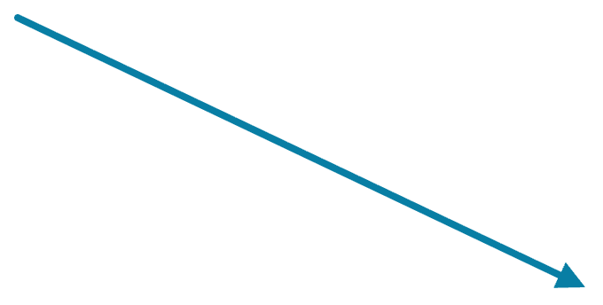
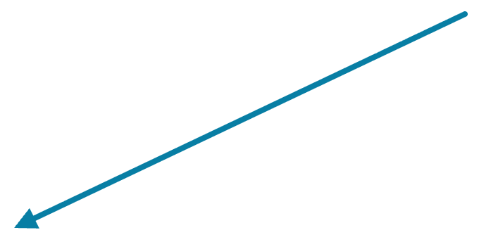
Custom hooks
React · Lecture 5
Reusable logic, like reusable components
UserList
PostList
useFetch
8
Notes:
Each component gets its own data; only the logic is shared. A custom hook is a normal function that uses other hooks inside. UserList calls useFetch with the users URL. PostList calls it with the posts URL. Same logic, different data. Compare: a component shares UI, a hook shares logic.

Slide 9


Rules of hooks
React · Lecture 5
Don't
Do
Inside if, loops or nested functions
At the top of a component or custom hook
Hook names start with use
9
Notes:
React tracks hooks by their order. On every render, React expects the same hooks in the same order. If a hook is inside an if or a loop, the order can change, and React mixes up the state. Hook names start with use, so React and the linter know it is a hook: useState, useEffect, useFetch.

Slide 10
useFetch
React · Lecture 5
const { data, loading, error } =
useFetch('https://jsonplaceholder.typicode.com/users');
20 lines become 1
10
Notes:
Open the hook file live; walk through it; she explains it back. Ask her line by line: What state does it keep? When does the effect run? Why is url in the array? What does it return? Reference version (useFetch.jsx): import { useState, useEffect } from 'react'; export function useFetch(url) { const [data, setData] = useState(null); const [loading, setLoading] = useState(true); const [error, setError] = useState(null); useEffect(() => { let ignore = false; async function load() { setLoading(true); setError(null); try { const res = await fetch(url); if (!res.ok) throw new Error('Request failed'); const json = await res.json(); if (!ignore) setData(json); } catch (err) { if (!ignore) setError(err); } finally { if (!ignore) setLoading(false); } } load(); return () => { ignore = true; }; }, [url]); return { data, loading, error }; } The ignore flag stops an old, slow request from overwriting new data.

Slide 11


Homework
React · Lecture 5
Todos from an API
Todos via useFetch
Loading and error states
Filter: done / not done
3–4 sentences on how useFetch works
11
Notes:
API for the homework: https://jsonplaceholder.typicode.com/todos. Each todo has a title and a completed field (true or false). Use completed for the done / not done filter. Use the useFetch hook from today. The written part: 3–4 short sentences, in her own words.

